Slide 1
AgriWatts: Empowering Farmers with Water Insights from NASA Data
Empowering the Future of Farming through Water Resource Management Team Cosmic Mantis

Slide 2
High-Level Overview
We developed a farmer-centric mobile app that integrates NASA Earth observation data to address water-related agricultural challenges. The app helps farmers access real-time insights about water availability, drought risks, soil moisture, and other hydrological factors, allowing them to optimize water use and make informed decisions.

Slide 3
The Challenge
Farmers face growing water-related challenges due to unpredictable weather patterns, floods, droughts, and pests. Without data-driven insights, managing water resources is difficult, and traditional farming methods are insufficient in the face of climate change. The challenge is to create a tool that simplifies access to NASA datasets, allowing farmers to make real-time, informed decisions about water management.

Slide 4
How Our Solution Works
The AgriWatts app empowers farmers by enabling them to select sections of land on a map and receive actionable insights about water resources. Key features include:
Real-time data integration from NASA Earth observation systems
Predictive analytics for drought and flood risks
Visual heat-maps and trend graphs for easy decision-making
Localized recommendations on water management

Slide 5
Key Features
Predictive Analytics: Provides forecasts on water availability and risks
Localized Insights: Uses both global and local datasets for accurate results
AI-Powered Recommendations: Suggests optimal water use and management techniques
Crop Health Monitoring: Uses multispectral imagery to track crop conditions
Offline Mode: Ensures farmers can access data even in remote areas
Community Feature: Farmers can share insights and strategies with others

Slide 6
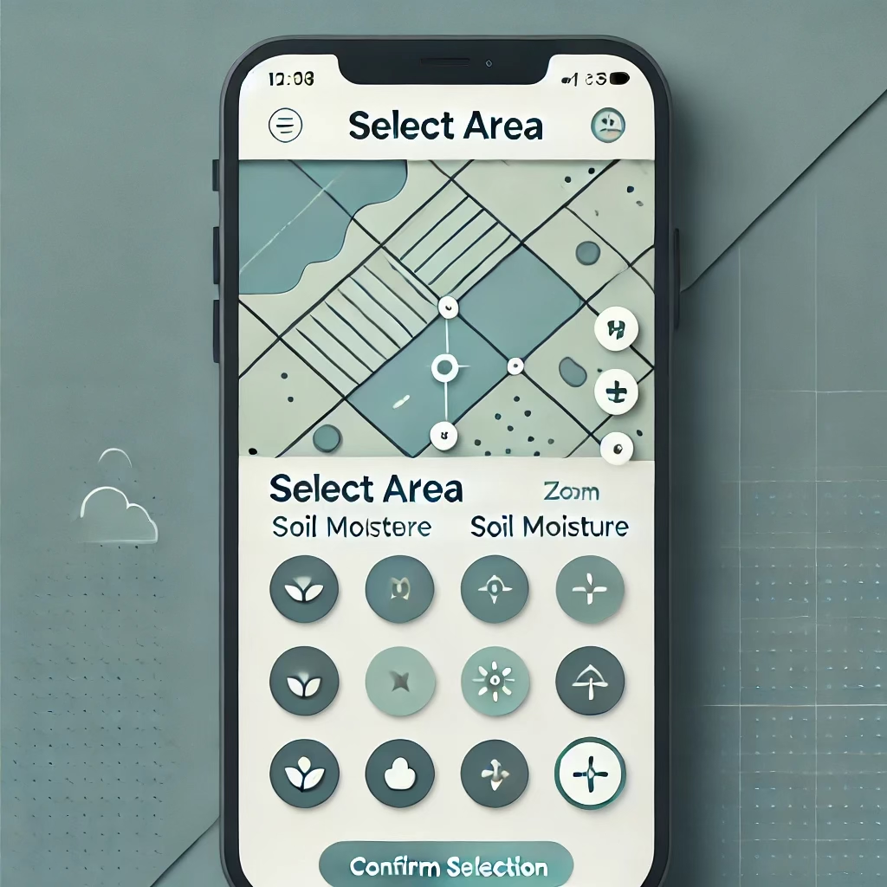
User Interface Design Overview
The AgriWatts app features a clean, intuitive user interface that prioritizes simplicity and ease of use for farmers. This prototype illustrates the Map Selection Screen, where farmers can interact with a map of their land to obtain insights on water-related concerns.
Key UI Features:
1. Map Interaction: The main feature is an interactive map that allows farmers to zoom in/out and select specific areas of their farm by drawing or clicking
2. Layer Controls: On the right side, farmers can toggle between different layers, such as Soil Moisture, Water Levels, and other environmental factors. These layers provide visual feedback using color-coded overlays, simplifying data interpretation
3. Select Area Tool: Farmers can outline the portion of land they are interested in analyzing, and the map highlights the selected region with subtle borders to indicate the area under examination
4. Real-time Data Visualization: The map integrates real-time data from NASA Earth Observation, shown through color-coded regions (e.g., green for optimal water levels, red for drought-prone areas)
5. Confirm Selection: At the bottom, a prominent “Confirm Selection” button allows farmers to submit their chosen area for analysis, leading to a detailed report and recommendations based on the data
6. Minimalist and Accessible Design: The design follows a nature-inspired color palette (greens and blues) and features large, easy-to-read fonts and simple icons, ensuring accessibility and a smooth user experience even in rural areas

Slide 7
Future Enhancements
Expand predictive models to cover more environmental variables (e.g., pest risks)
Enhance AI-driven recommendations with advanced machine learning models
Integrate government and NGO support features for disaster relief and funding
Develop multilingual support to cater to a global farming audience

